Slide 1
CREDIT SCORE CALCULATION USING MACHINE LEARNING APPROACH AND RISK CALCULATION USING MORAN'S I
Samim Piyada(csug-158-20)
Ayan Naiya(csug-148-20)
RKMRC,NARENDRAPUR

Slide 2
Abstract
Advancing towards financial technology (fintech) have facilitated new ways of doing business in the financial services industry. Financial institutions involved in lending are now compelled to push their offerings closer to the market than before, be more transparent and non-discriminating in their credit underwriting and to reduce their loan application turnaround

Slide 3
Introduction
The objective of this project was to leverage advanced machine learning techniques, specifically Moran's I and various algorithms, to analyze loan payment history and identify risk zones in different Indian states.
By identifying these risk zones, we aim to assist financial institutions, policymakers, and other stakeholders in making informed decisions related to loan disbursement, risk assessment, and resource allocation.
In the following slides, we will explore the background, methodology, results, and implications of our project, shedding light on how it can contribute to a more efficient and targeted approach to managing financial risks in India.

Slide 4
Background
Traditional risk assessment methods often rely on limited factors and may not capture the complex spatial dynamics that influence loan payment behaviour. This limitation calls for the integration of machine learning techniques into the analysis.
Our project combines the power of Moran's I, a spatial autocorrelation statistic, with machine learning algorithms to uncover spatial patterns and associations within loan payment histories across Indian states.

Slide 5
Methodology
Data Collection: We gathered loan payment data from financial institutions operating in various states across India.
Data Pre-processing: The collected data was cleaned, standardized, and transformed into a suitable format for analysis.
Spatial Autocorrelation Analysis: We employed Moran's I statistic to assess the spatial dependence of loan payment behaviour, considering neighbouring states' loan payment patterns.

Slide 6
Spatial Autocorrelation or Moran’s I
The key idea behind Moran's I is to compare the observed spatial arrangement of values with what would be expected under spatial randomness or independence. It evaluates whether similar values are clustered together (positive spatial autocorrelation) or dispersed (negative spatial autocorrelation) across the study area.
The calculation of Moran's I involves three main components: the observed values of the variable, a spatial weights matrix, and the mean value of the variable. The spatial weights matrix defines the spatial relationships between locations and determines the neighbors of each location for measuring similarity.

Slide 7
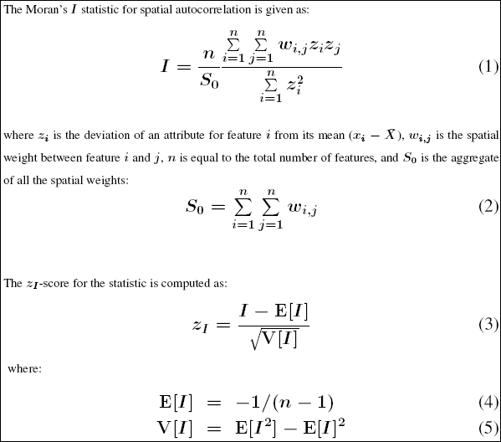
Moran's I ranges from -1 to 1, It helps identify clusters or hotspots of similar values, understand spatial processes, and provide a basis for further analysis and decision-making in various fields such as urban planning, environmental science, public health, and economics

Slide 8
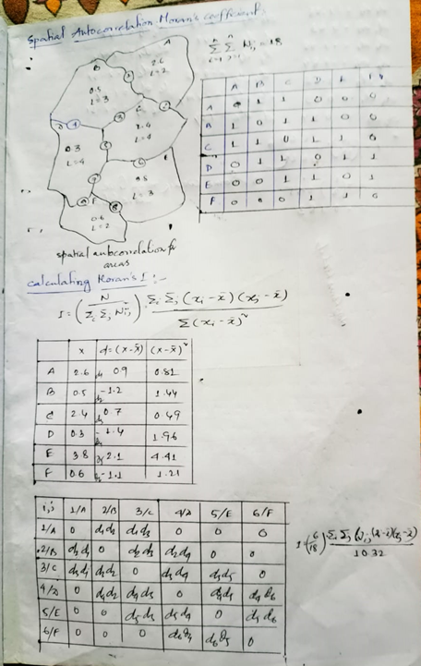

Slide 9
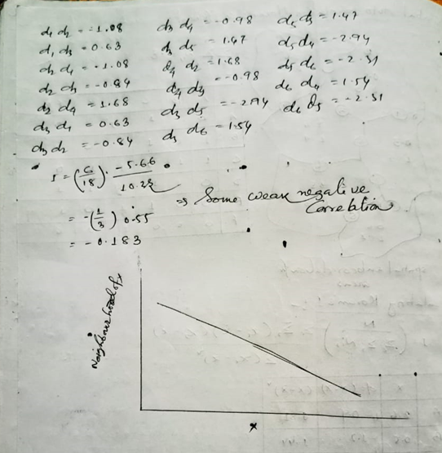

Slide 10
Results:
The analysis of loan payment history using Moran's I and machine learning algorithms yielded significant insights into the risk zones across Indian states.
Our models successfully classified states into risk zones, such as low risk, moderate risk, and high risk, based on loan payment behaviour.
By visualizing the results on a map, we observed spatial clusters of high-risk states, indicating geographical patterns of loan defaults and repayment challenges.
These findings can serve as a valuable resource for financial institutions and policymakers to prioritize risk mitigation strategies, allocate resources efficiently, and develop targeted policies.

Slide 11
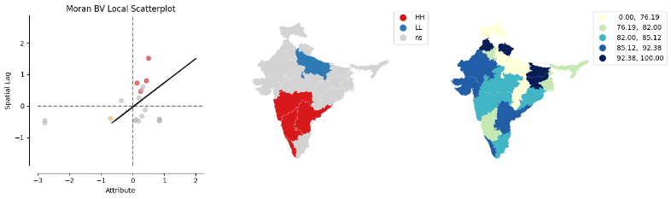

Slide 12
HH(High-High):refers to pairs of locations that have high values for the variable of interest and are geographically clustered or adjacent to each other.
High-Low (HL): Pairs of locations where one has a high value and the other has a low value. This represents a negative spatial autocorrelation or a dispersion pattern.
Low-High (LH): Pairs of locations where one has a low value and the other has a high value. Similar to HL, this represents a negative spatial autocorrelation or a dispersion pattern.
Low-Low (LL): Pairs of locations where both have low values. This indicates a positive spatial autocorrelation or clustering of low values.

Slide 13
Implications:
The implications of our project are far-reaching and can benefit various stakeholders: Financial Institutions: Enhanced risk assessment enables better loan portfolio management, reducing potential losses and improving overall profitability.
Policymakers: Accurate identification of risk zones helps in designing targeted policies, interventions, and regulatory frameworks to support vulnerable regions.
Investors: Risk-aware investment decisions can be made by considering the risk zones

Slide 14
Reference:
1.Credit Scoring using Machine Learning Approaches:
Author: Bornvalue Chitambira
Supervisor: Christopher Engstr¨om
2. Good Credit and the Good Life: Credit Scores Predict Subjective Well-Being
Joe J. Gladstone
Ashley Whillans
3. THE AWARENESS ABOUT THE CIBIL SCORES AMONG THE VARIOUS CUSTOMERS OF COMMERCIAL BANKS IN CENTRAL KERALA (A STUDY WITH REFERENCE TO GOVT.EMPLOYEES) GREESHMA SAJAN, Assistant Professor, Calicut Adarsha Sanskrit Vidyapeetha, Balussery , Kerala
4. International Journal of Computing, Programming and Database Management 2020; 1(1): 22-25
Gandla Venkatesh Dhamodhar Department of Computer Science, Sri Venkateswara University, Tirupati, Andhra Pradesh, India
5. COVID19 IMPACT ON CIBIL REPORT AND LOAN REPAYMENT CAPACITY OF BORROWERS (Special reference to Loan Moratorium, Loan Restructuring & Loan default)
Rashmi Somani(Medi-Caps Institute of Technology and Management)
Insha Mohammad(Medi-Caps Institute of Technology and Management)
Kapil Kumar Tiwari(Medi-Caps University)

Slide 15
6. Analysis and Prediction of CIBIL Score using Machine Learning
November 2021 Journal of Information and Computational Science 10(10):248-253
Authors:Sunil Dhore(Army Institute of Technology)
7. Machine Learning based Cibil Verification System
1G. Elizabeth Rani Assistant Professor, CSE, Kalasalingam Academy of Research and Education Anand Nagar, Krishnankoil, India. g.elizabeth@klu.ac.in
4A.Sai Sri Harsha Student, Department of CSE, Kalasalingam Academy of Research and Education Anand Nagar, Krishnankoil, India. saisriharsha100@gmail.com
2A.Tirumala Vikas Reddy Student, Department of CSE, Kalasalingam Academy of Research and Education Anand Nagar, Krishnankoil, India. vikas.sunny99@gmail.com
5M. Sakthimohan Assistant Professor, ECE, Kalasalingam Academy of Research and Education Anand Nagar, Krishnankoil, India. sakthimohan.phd@gmail.com
8. How Spatial Autocorrelation (Global Moran's I) works
9. Arthur Getis J. K. Ord The Analysis of Spatial Association by Use of Distance Statistics
10. US Drug Overdose: Spatial Autocorrelation, CRAIG CHILVERS

Slide 16
THANK YOU

